Slide 1

Inflation and its effects
Analysis of the Impact of Inflation on Growth and Unemployment Rates in the World and Specifically in Egypt (2014-2024)

Slide 2
Analysis of the Impact of Inflation on Growth and Unemployment Rates in the World and Specifically in Egypt (2014-2024)
Presented by: Mahmoud Abdelazeem Ahmed Eslam Mansour Meshwad
Supervised by: Amal Mahmoud
Introduction: "This project aims to analyze the impact of inflation on growth and unemployment rates during the period from 2014 to 2024 in countries around the world, with a special focus on Egypt."

Slide 3
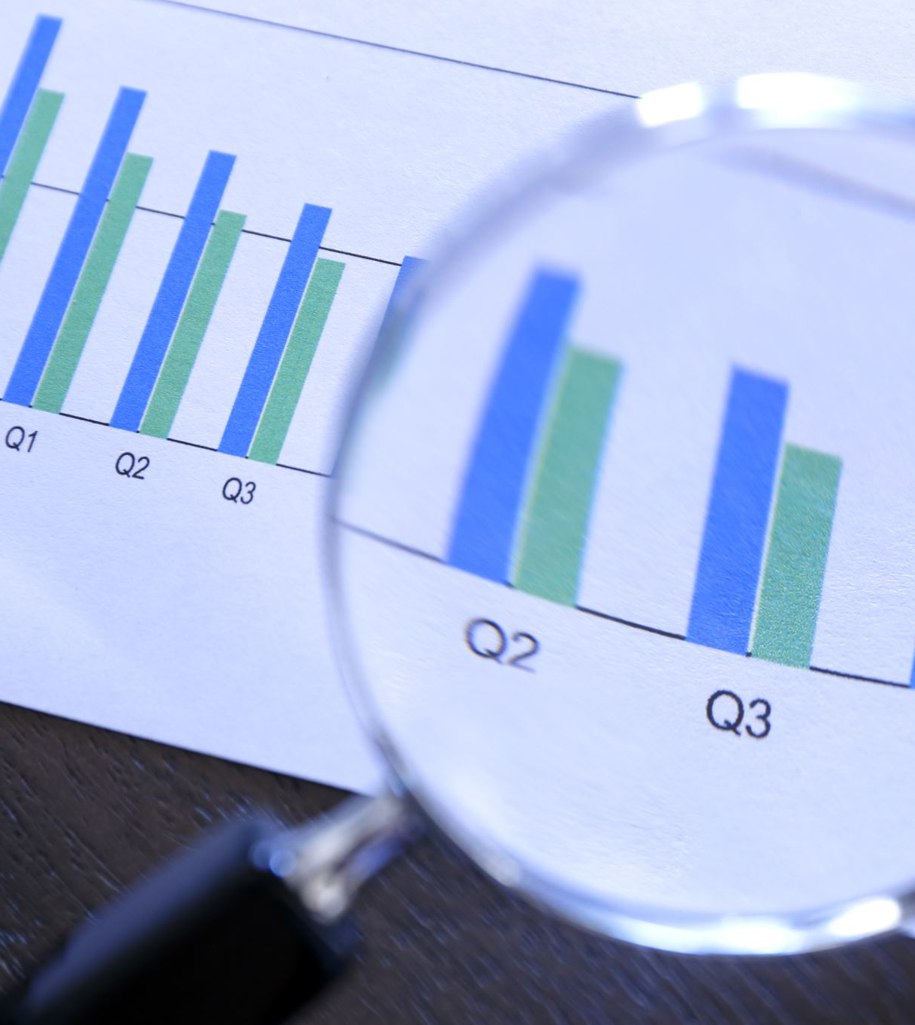
Objectives
The main objectives of the project are:
Analyze the impact of inflation on growth and unemployment rates in various countries between 2014 and 2024.
Study the relationship between inflation rates and unemployment rates in Egypt compared to other countries.
Extract economic trends to assist policymakers in formulating appropriate economic policies.

Slide 4






Data Used
The main tables in the project are:
world_GDP: Contains annual economic growth data for each country, including average growth rates.
world_inflation: Contains annual inflation rates for each country.
world_unemployment: Contains unemployment rates by gender and age group, along with average unemployment rates.
Sources:
Data collected from reliable global economic reports and platforms for the period from 2014 to 2024.

Slide 5

Methodology
The steps followed in the project are:
Data Collection: Data was gathered from multiple sources regarding inflation rates, economic growth, and unemployment.
Database Construction: MySQL was used to create a database containing the related tables.
Analysis:
Excel: Used for preliminary data analysis and manipulation.
Python: Utilized for more complex data analysis and implementing statistical models.
Tableau: Employed for data visualization and creating charts and reports.
Data Linking: The tables were linked using country identifiers and time periods to conduct cross-analysis between inflation, growth, and unemployment.

Slide 6

Data Analysis
Key Data Analyses:
Analyzed trends of inflation rates, economic growth, and unemployment rates globally and in Egypt.
Studied the impact of inflation on economic growth and unemployment rates in Egypt compared to other countries.
Analyzed the interrelationship between the three rates: how inflation affects growth, how growth impacts unemployment, and how inflation influences unemployment.
Effects of Inflation:
On Global Countries: Inflation can lead to reduced economic growth rates in several countries, with varying effects on unemployment depending on local economic conditions.
On Egypt Specifically: High inflation rates in Egypt have significantly impacted economic growth and contributed to higher unemployment rates, particularly among youth and vulnerable demographics.
Charts:
Tableau: Used to visualize data and create charts illustrating the relationships between inflation, economic growth, and unemployment.
Show the impact of inflation on unemployment rates in Egypt and other countries.

Slide 7


Key Findings
The findings reached are:
Inflation and Economic Growth Relationship: Some countries with high inflation showed a decline in economic growth rates, while countries with low inflation experienced better growth.
Unemployment in Egypt: The age group of 15-24 was the most affected by unemployment rates during this period.
Global Comparison: Egypt experienced high inflation rates that negatively impacted economic growth, but when compared to other countries, the unemployment rates were affected by local economic policies.

Slide 8

Recommendations
Recommendations based on the analysis:
For the Egyptian Government: Control inflation rates through more stable monetary policies to improve economic growth rates.
For Policymakers: Focus on improving job opportunities for youth through long-term development programs to combat unemployment.
General Recommendations: Countries with low inflation should aim to maintain price stability for sustainable growth.

Slide 9
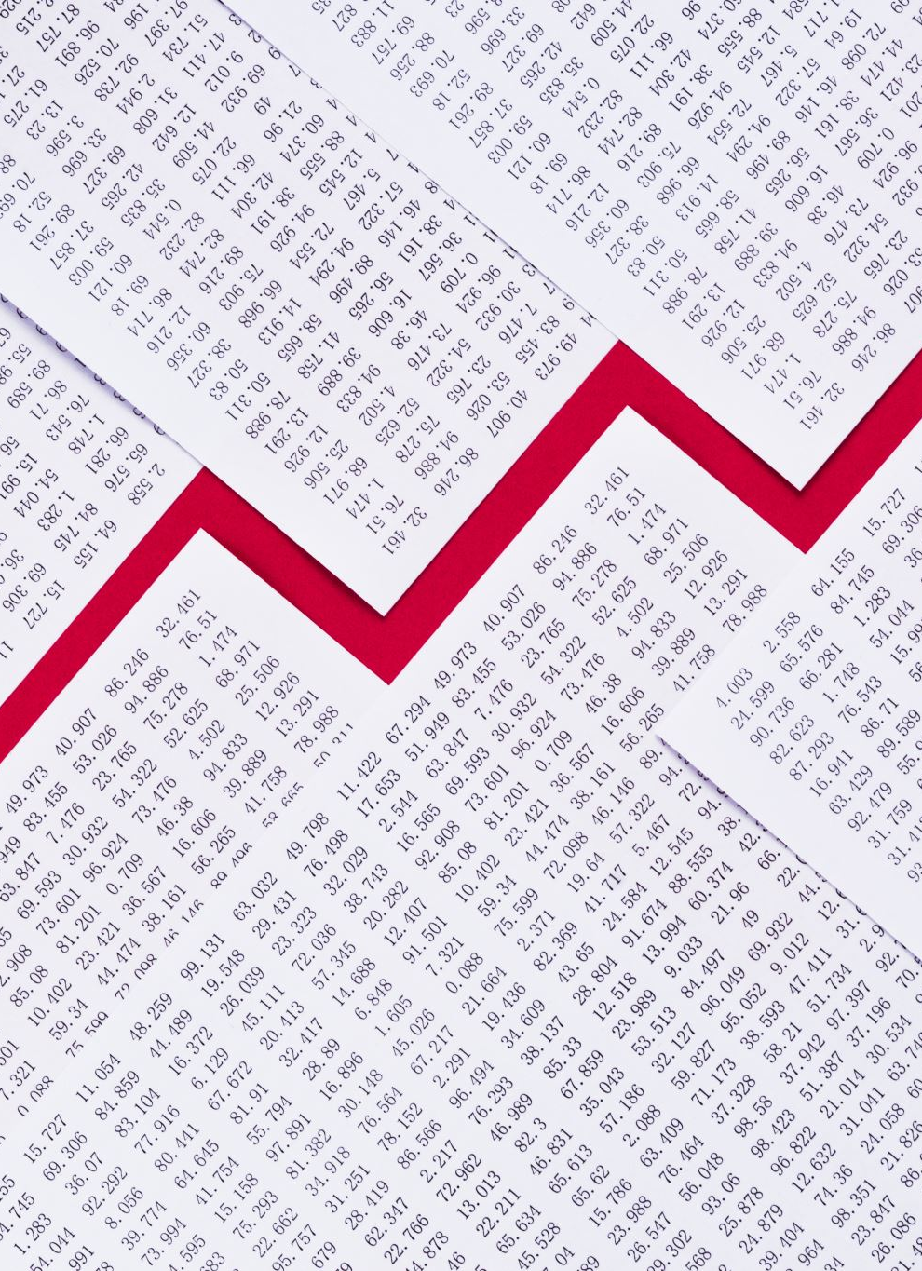
Conclusions
Countries that achieved a balance between inflation and
economic growth saw improvements in unemployment rates.
Egypt needs more stable economic policies to address inflation and unemployment.
The analysis confirms that inflation directly affects economic growth rates and should be monitored closely to achieve sustainable development.

Slide 10
Acknowledgments
Special Thanks to: Supervisor [ Amal Mahmoud ] for her support and guidance throughout the project.
Partners:
Special thanks to my partners in the project, [Ahmed and Mansour], for their cooperation and efforts in this work.

Slide 11

Questions?

